Slide 1
Office 365 REST API Deep Dive
github.com / andrewconnell / pres-o365-restapi

Slide 2






Andrew Connell
www.AndrewConnell.com
me@AndrewConnell.com
@andrewconnell
Full stack web developer & instructor
Co-host, Microsoft Cloud Show – www.MicrosoftCloudShow.com
Hands-On SharePoint Training Critical Path Training - www.CriticalPathTraining.com
On-Demand SharePoint Training Pluralsight – www.Pluralsight.com

Slide 3
Topics
Overview
Microsoft’s Approach to APIs & SDKs in Office 365
Working with REST APIs in .NET Projects
Office 365 REST APIs
Batching REST Requests

Slide 4
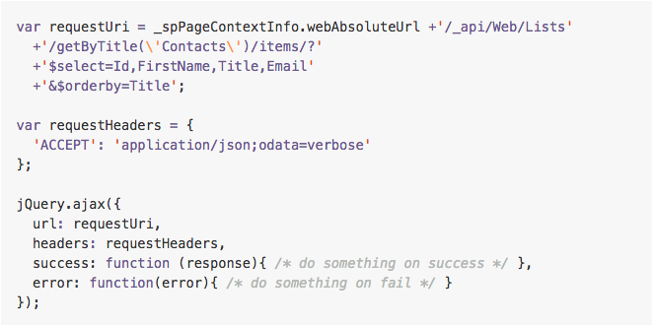
Getting All Items, Sorted

Slide 5
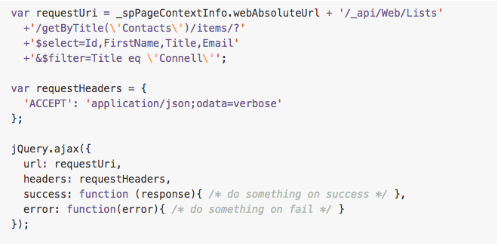
Getting Specific Item(s)

Slide 6
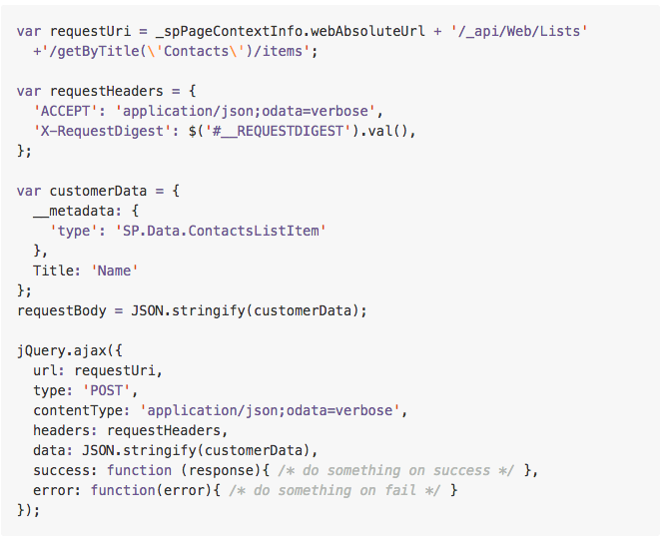
Creating an Item

Slide 7
Updating an Item

Slide 8
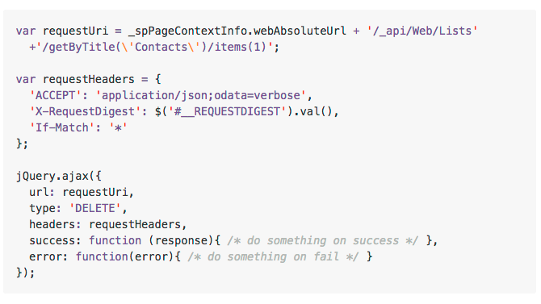
Deleting an Item

Slide 9
Microsoft’s Approach to APIs & SDKs in Office 365

Slide 10
Microsoft’s Approach to APIs & SDKs in Office 365
All product teams focus on improving and innovating the REST APIs for specific product areas first
Native SDKs are simply wrappers to REST APIs
.NET
Mobile: iOS & Android
Cross Platform: Cordova & Xamarin

Slide 11
Understanding the Versioning in O365 REST APIs
https://../api/v1.0/
Production ready REST APIs
Native SDKs target these
https://../api/v2.0/
Breaking or significant changes will go in new APIs
For example: OneDrive v2
https://../api/beta/
Preview APIs

Slide 12
Working with REST APIs in .NET Projects

Slide 13
Make Working with JSON Easier – JSON.NET
.NET cannot read / parse JSON natively
Instead of parsing REST requests & responses as raw text, convert to strongly typed objects
Use Paste JSON as Classes in Visual Studio & JSON.NET
http://www.newtonsoft.com/json

Slide 14
Working with JSON.NET
Execute a request against the raw REST endpoint
Fiddler – http://fiddlertool.com
Postman - https://www.getpostan.com
CURL - http://curl.haxx.se
Copy JSON response to clipboard
Paste as classes in Visual Studio
Massage the code
Use JSON.NETs serializer / deserializer to convert strings to classes & vice versa

Slide 15
Using JSON.NET with JSON in .NET Projects

Slide 16
Office 365 REST APIs

Slide 17
Exploring the Office 365 REST APIs
SharePoint Online
Exchange Online
Groups API
Video API
OneDrive API
OneNote API

Slide 18
Office 365 REST APIs

Slide 19
Batching with REST

Slide 20
Batching Support Added to O365
Office 365 REST APIs shipped with support for support with REST APIs
Batching requests with REST support added to SharePoint Online late 2014
Send multiple write & read operations in one HTTP request
SharePoint 2013 on-premises – not supported

Slide 22
Overview - Batch Request
BATCH REQUEST
CHANGESET - HTTP POST
CHANGESET - HTTP PATCH
CHANGESET - HTTP DELETE
HTTP GET

Slide 23
Overview - Batch Response
BATCH RESPONSE
CHANGESET RESPONSE
CHANGESET RESPONSE
CHANGESET RESPONSE
HTTP GET RESPONSE

Slide 24
Exploring Batch Requests & Responses

Slide 25
More on SharePoint Batching
SharePoint REST API Batching
Understanding Batching Requests http://aconn.me/14lmhyz
Exploring Batch Requests, Responses & Changesets http://aconn.me/14lmhhV
SharePoint REST Batch Executor
https://github.com/SteveCurran/sp-rest-batch-execution

Slide 26


Want to Learn More?
www.CriticalPathTraining.com
Hands-On & Virtual Training
www.Pluralsight.com
On-Demand Training
SharePoint Courses for Everyone
SharePoint 2007, 2010 & 2013
Developers, Administrators & End Users
Get Training How You Like it
Hands-On (classroom with hands-on labs)
Online (live webcast with take-away labs)
Private Classes Available for Large Groups
SharePoint Courses for Everyone
SharePoint 2007, 2010 & 2013
Developers, Administrators & End Users
Individual, Small Business & Enterprise Plans
Monthly or Annual Subscriptions
Watch Online & Offline
Subscribers Have Access to Entire Catalog
me@andrewconnell.com

Slide 27

Thanks! Questions?
github.com / andrewconnell / pres-o365-restapi

